Slide 1
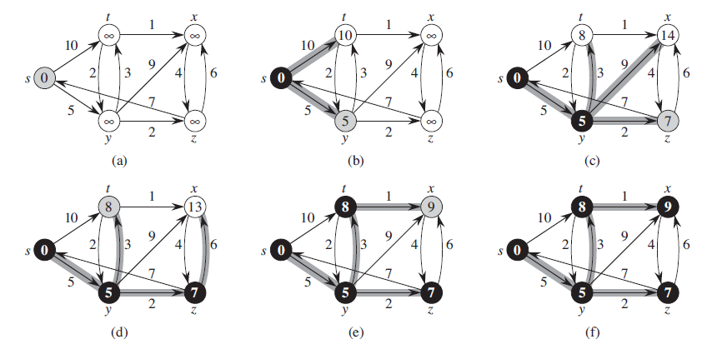
Dijkstra’s Algorithm
Find The Shortest Path
Michael Uftring
Indiana University
I-590 Data Visualization
Fall, 2017
http://www.codebytes.in/2014/08/dijkstras-algorithm-implementation-in.html

Slide 2
Introduction
What is this project about?
What will be presented?

Slide 3
Objectives (1)
Purpose
Motivation

Slide 4
Objectives (2)
A dev-type project, instead of a data analysis project

Slide 5
Dijkstra’s Algorithm (1)
What is it?
How does it work?
Why is this interesting and important?
Where is this used?

Slide 6
Dijkstra’s Algorithm (2)
By Shiyu Ji - Own work, CC BY-SA 4.0, https://commons.wikimedia.org/w/index.php?curid=54537901

Slide 7
Dijkstra’s Algorithm (3)

Slide 8
Dijkstra’s Algorithm (4)

Slide 9
Dijkstra’s Algorithm (5)

Slide 10
Existing (intro)
Found 4 or 5
Will showcase just 2 or 3 here (in the interest of time)

Slide 11
Existing-1 (1)

Slide 12
Existing-1 (2)

Slide 13
Existing-1 (3)

Slide 14
Existing-2 (1)

Slide 15
Existing-2 (2)

Slide 16
Existing-2 (3)

Slide 17
Existing-3 (1)

Slide 18
Existing-3 (2)

Slide 19
Existing-3 (3)

Slide 20
Summary
The good
The bad

Slide 21
Project Details
Now that we know about Dijkstra’s algorithm
And we have seen some existing visualizations
Why this project?

Slide 22
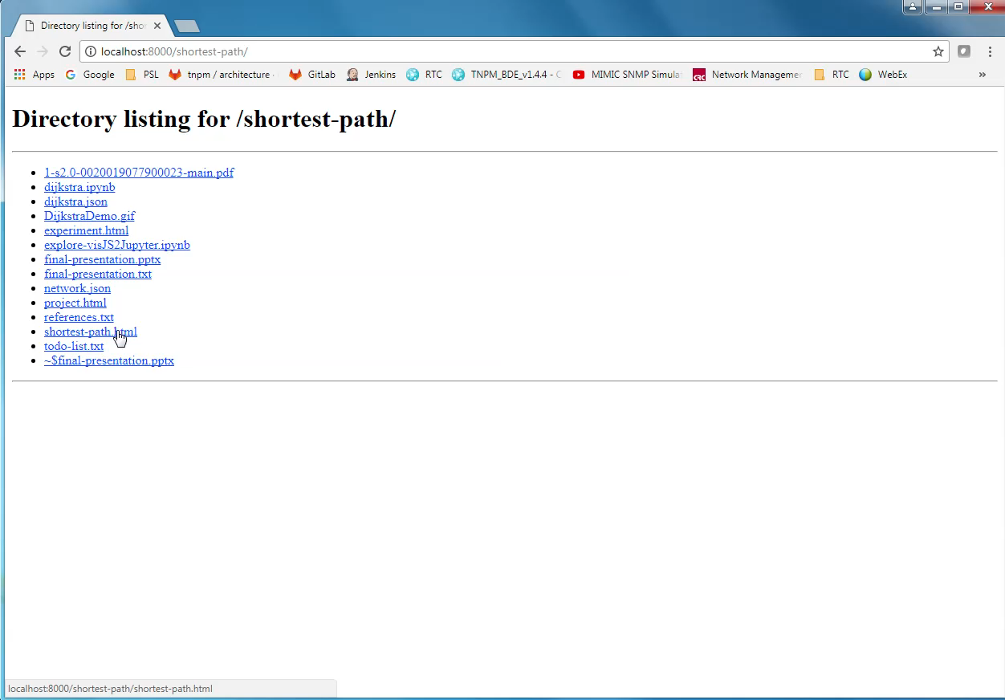

Slide 37
What’s Next?

Slide 38
Lessons Learned

Slide 39
Conclusion (1)
Did D3 make this project easy?

Slide 40
Conclusion (2)

